Slide 1
Vigyaan’17
- INFORMATION TECHNOLOGY

Slide 2

Team H-A-D
Working on
Medicine finder

Slide 3
Problem Statement
People have to search each and every store to find the required medicine. Although there are applications for ordering medicines online but they also cause a time delay. Develop a mobile app where all medicine shops are registered.
The user can use this app for the following purpose:
• Search the availability of any medicine in nearby stores.
• Tracking the address using GPS.
• Order the medicine in any emergency situation.
Shopkeeper Interface:
Uploading the names of their stock of drugs of each type in the app.
Providing their contact number for other enquiries/details.
Contacting and ordering from nearby stores in case of empty stock of any drug in emergency situations.

Slide 4
What We See ?
India is the diabetes capital of the world (TOI)
High B P is responsible for 57% of all stroke deaths (NCBI)
improper
The Reason reported for all these are
due to in time and
causing No Regular checkup.
medications,
lack of availability of Medicines
Improper Record maintenance

Slide 5
Solution:-
We filter shops according to availability of medicine and distance,
We provide generic alternative,
Calling ambulance/ sending SOS ,
Check-up reminder (customer),
Stock update reminder (shopkeeper).

Slide 6
Who Will Be benefited?
Four major type of Patients need a Good Care and Medicines on a Regular Basis:
Diabetic Patients,
Blood Pressure Patients,
Thyroid Patients,
Mother and New Born Babies,
Two types of Shopkeepers:-
Retailer And Wholesaler.

Slide 7
What We Will Do?
Provide a Service Platform:
For any-time enquiry & delivery of Medicines, Pharmaceutical and Health Products,
For Helping users in managing Health Records,
To remind routine Health Checkups,
To remind Purchases (to Retailer) for customer’s Stock Management.

Slide 8
How it Works?
Login
Customer
Search
Reminder
Retailer
Stock
SOS
Shop
Medicine
update
Order
Doctor
Check-up
medicine

Slide 9
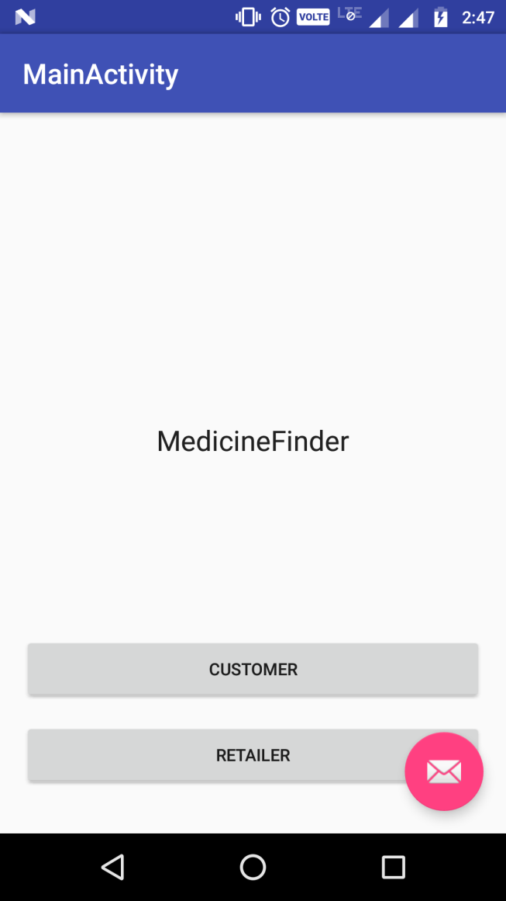
Layout of our App
Splash Screen
Medicine finder

Slide 10
Selection point
Retailer
Customer

Slide 11
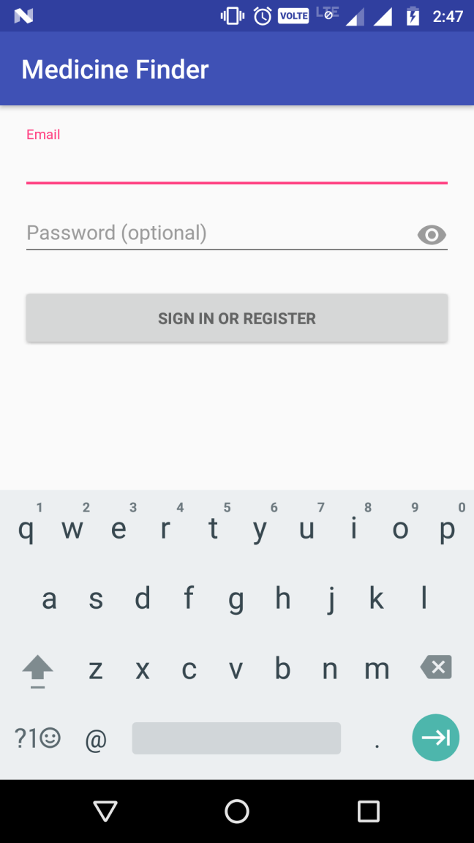
SIGN-UP/ LOGIN

Slide 12
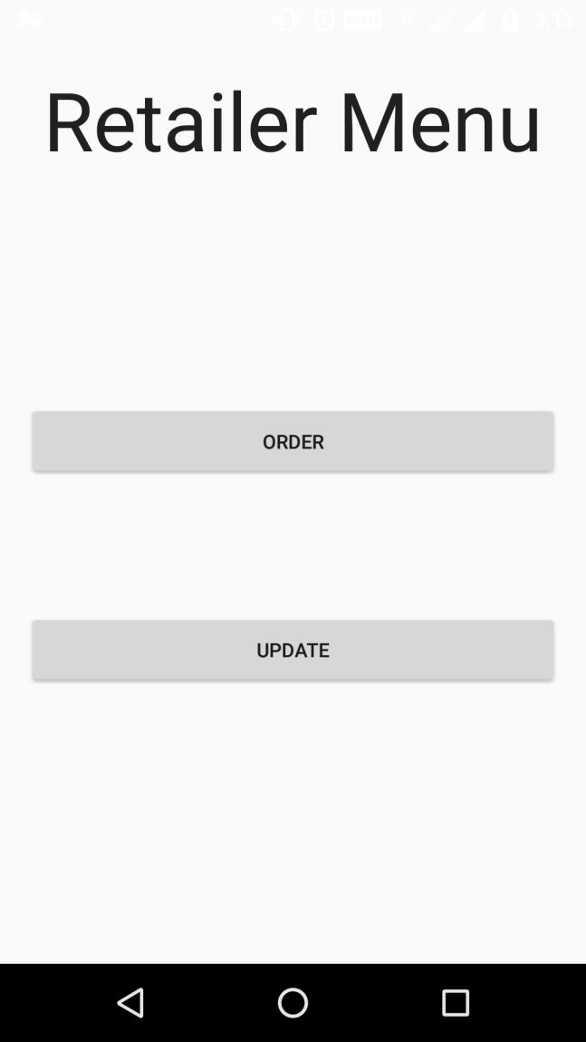
STOCK REGISTER
MEDCINE NAME | QUANTITY | EXP
RETAILERS MENU

Slide 14
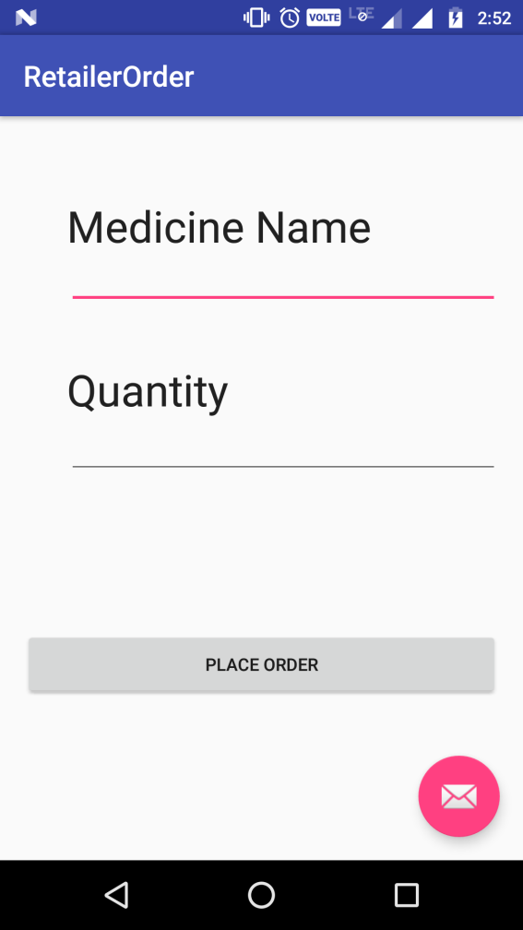

Slide 15
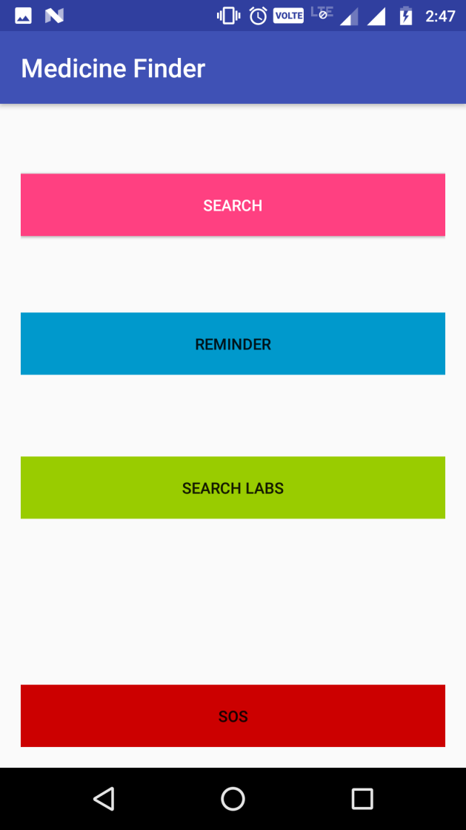
CUSTOMER MENU

Slide 16
THANK YOU

